Slide 1
REACT FUNCTION COMPONENTS & STATE HOOKS
Created for Microsoft / TNT
Notes:
http://bit.ly/supdecogit

Slide 2
Learning Objectives
TNTs will understand how the intro blocks of HTML, CSS, JS and React are used in the app.
TNTs will learn how to add a React function component and JS logic, manage app props, add input that affects the app.

Slide 3
PART 0 VS Code Tip
Comparing files

Slide 4
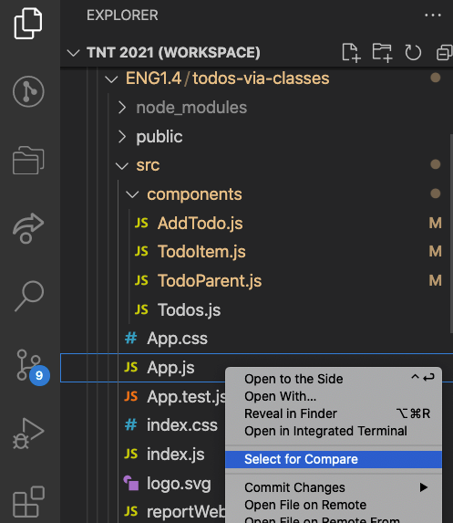
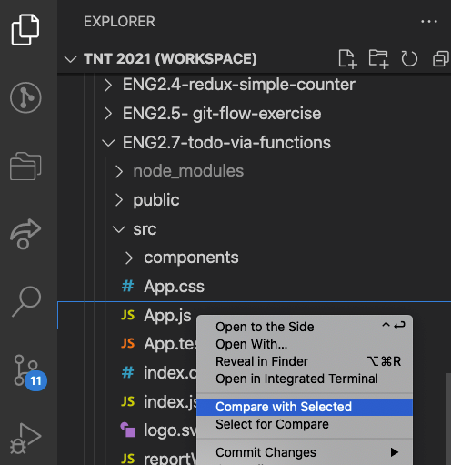
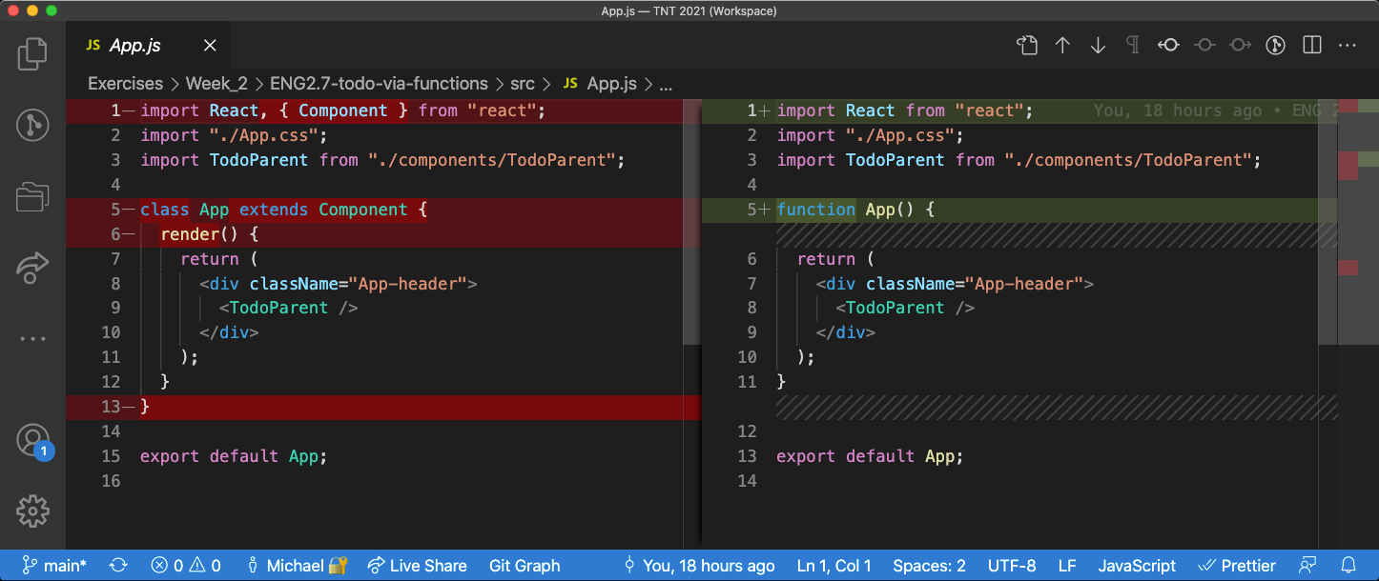
Comparing files

Slide 5
PART 1 FUNCTION COMPONENTS

Slide 6
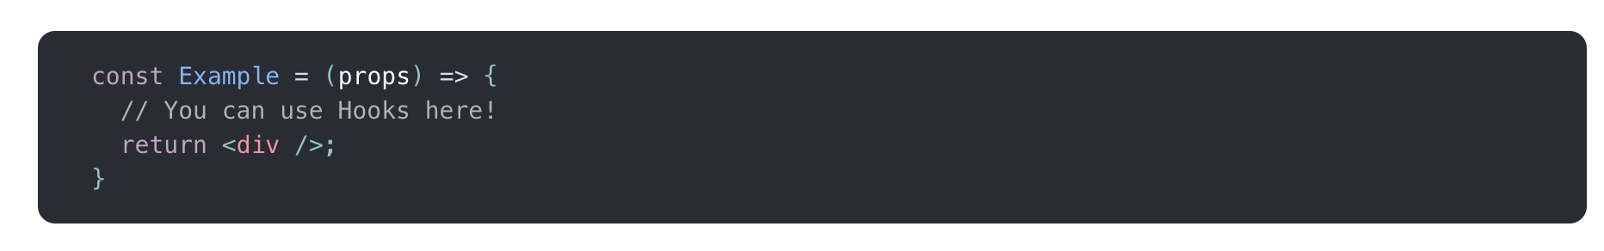
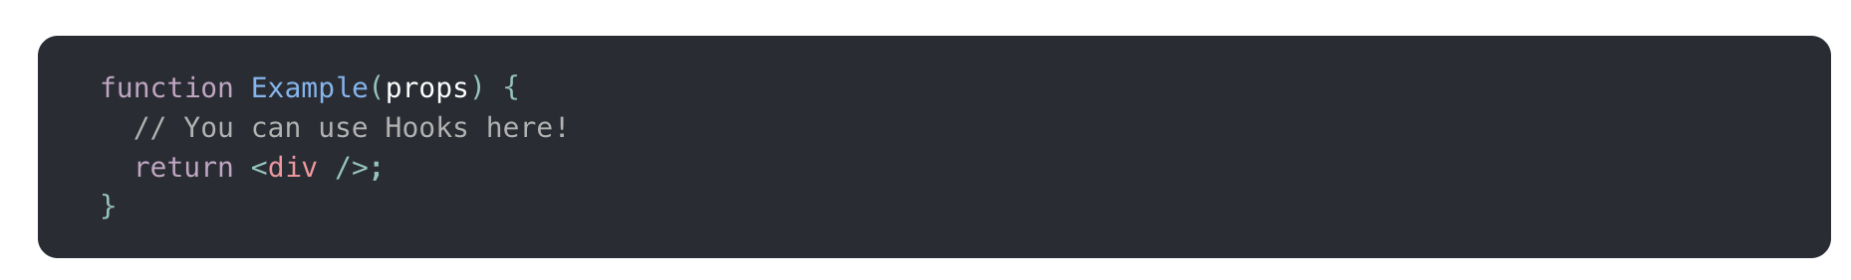
<Example> </Example>
With lambda
Without lambda

Slide 7
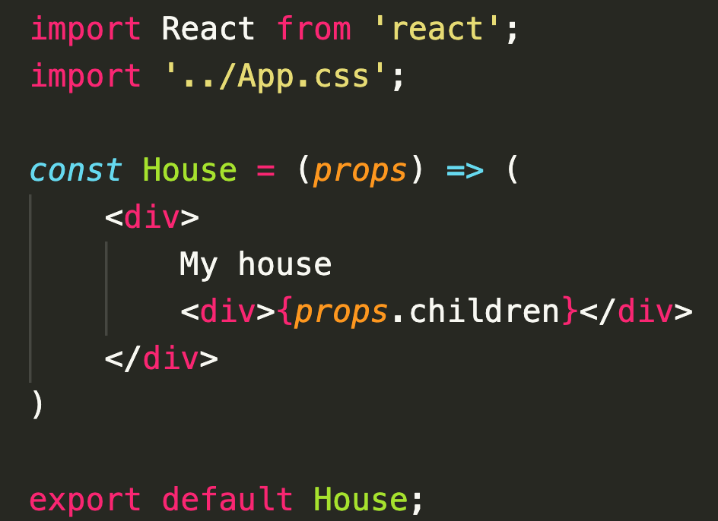
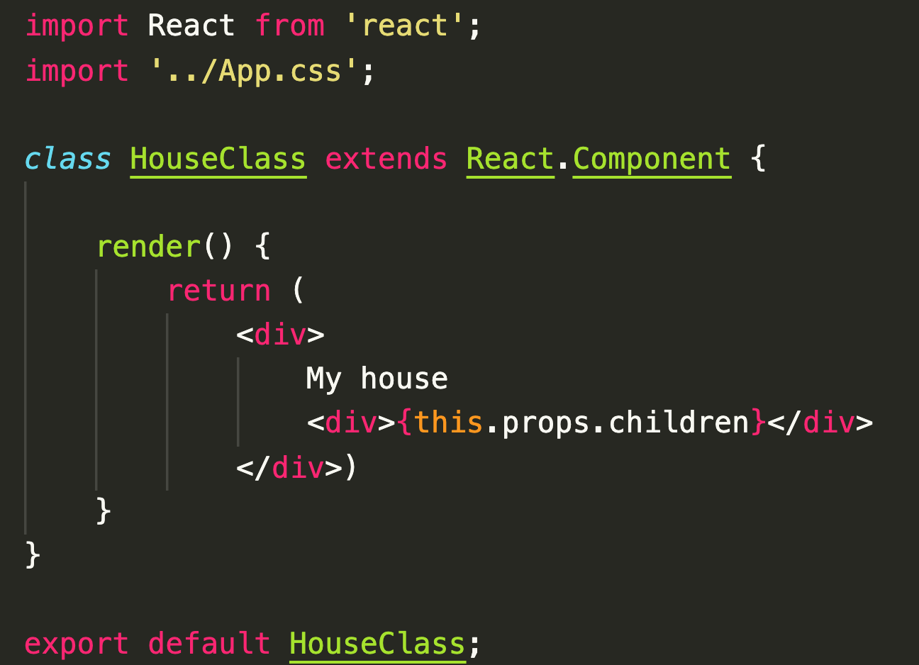
Comparing class and function components
Function
Class

Slide 8
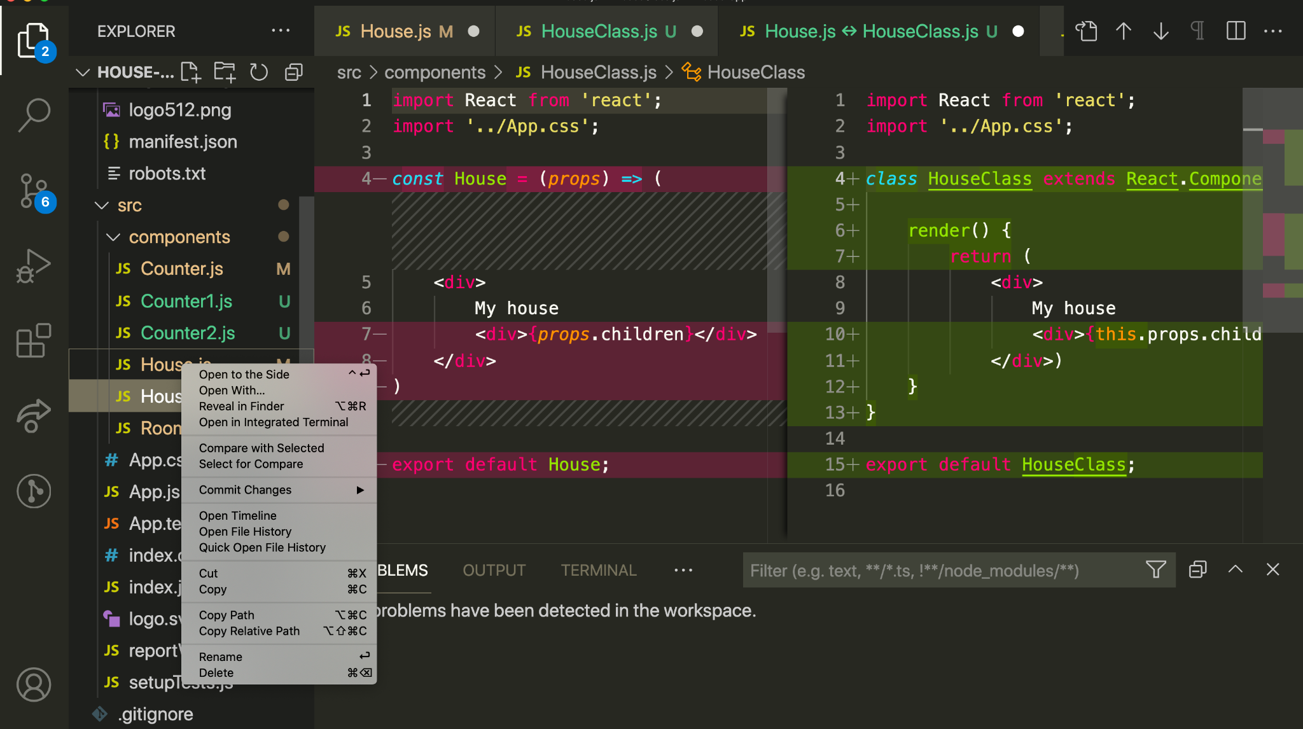
Select to compare
Compare with selected

Slide 9
PART 2 HOOKS

Slide 10
What is a hook?
A Hook is a special function that lets you “hook into” React features.
For example, useState is a Hook that lets you add React state to function components.
State hook are hooks for adding a state to a function component.
When would I use a Hook?
If you write a function component and realize you need to add some state to it, previously you had to convert it to a class.
Now you can use a hook inside the existing function component. We’re going to do that right now!
https://reactjs.org/docs/hooks-state.html

Slide 11
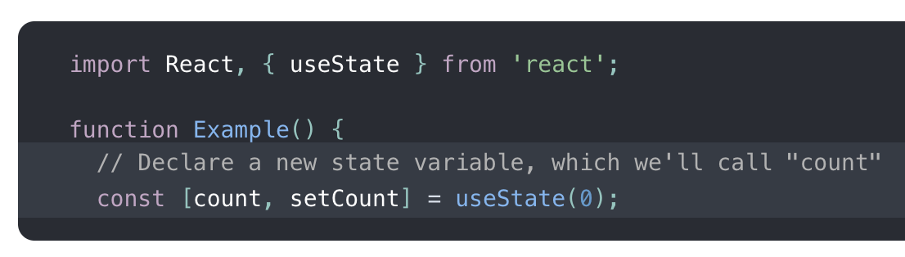
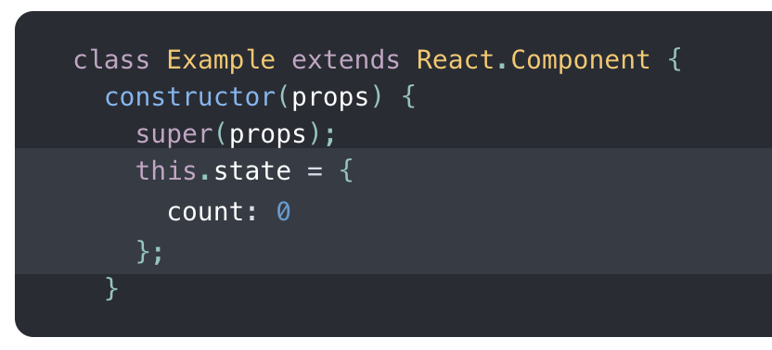
Example of state hook
Function with state hook
Class with state
useState hooks directly inside a component
count is the state variable
The argument of useState is the initial state
useState returns a pair of values - the current state and a function that updates it, here setCount
State
setState function to update the stace

Slide 12
Rules of Hooks
https://reactjs.org/docs/hooks-rules.html
Call Hooks from React function components only (not from JS functions)
Don’t call Hooks inside loops, conditions, or nested functions.
Call Hooks in the same order each time a component renders.

Slide 13
PART 3
TODOLIST WITH STATE HOOKS
https://github.com/tnt-summer-academy/Exercises/tree/main/Week_2/ENG2.7-todo-via-functions
Notes:
https://github.com/tnt-summer-academy/Exercises/tree/main/Week_2/ENG2.7-todo-via-functions

Slide 14
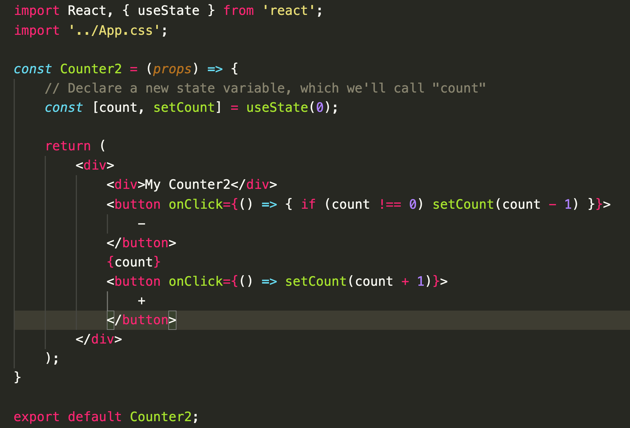
Counter with state hook
Let’s code the Counter component with state hook

Slide 15
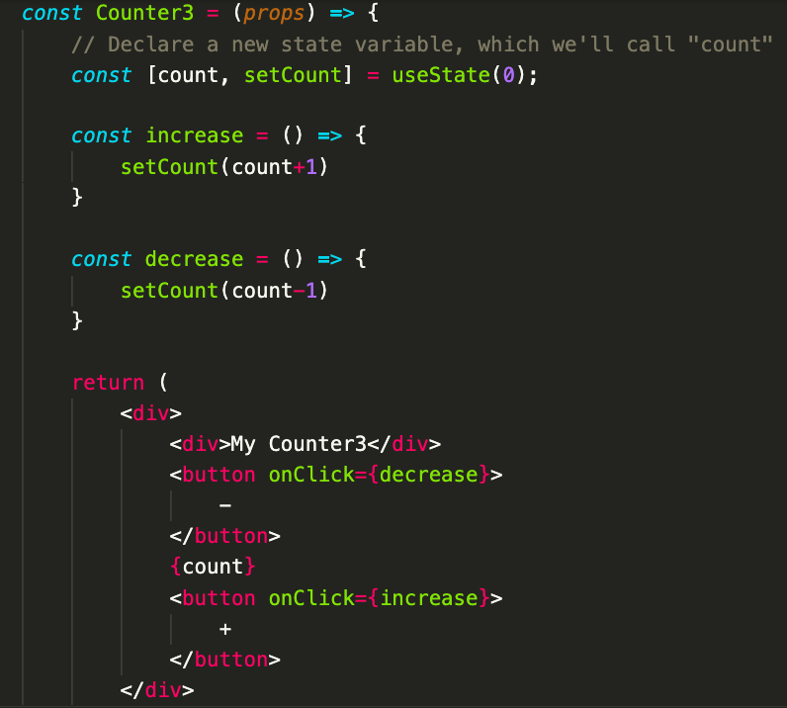

Slide 16
PART 4
TODOLIST WITH STATE HOOKS

Slide 17
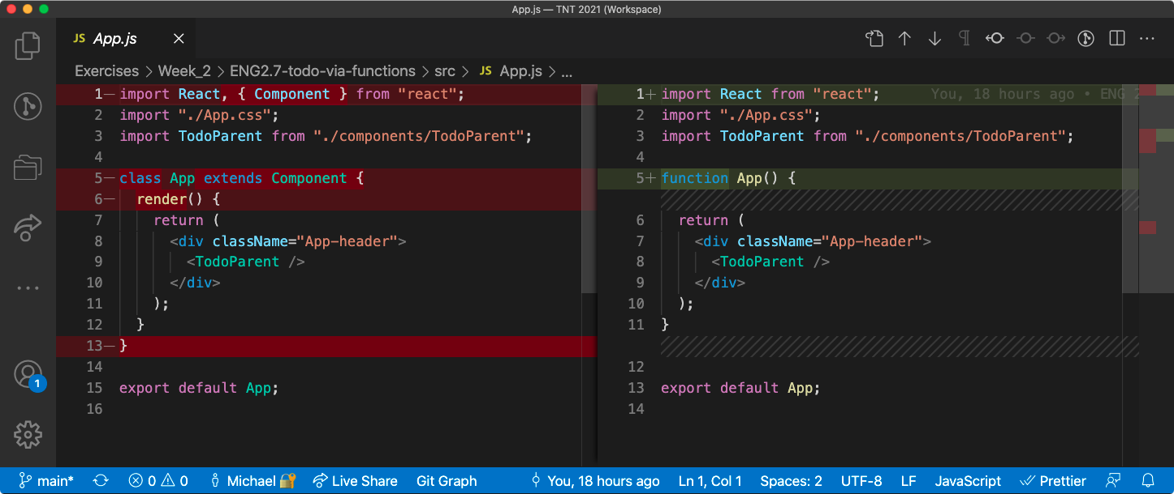
Compare the code for todolist with classes and todolist with hooks

Slide 18
Exercise
Compare the code
Add new features to the code
How did it go?

